Slide 1
NETWORK COMPONENTS

Slide 2
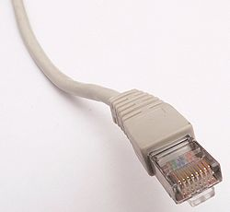
A standard RJ45 connector used most commonly on cat5 cable, a type of cabling used primarily in Ethernet networks.

Slide 3


Slide 4
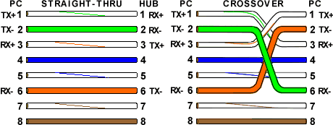

Slide 5
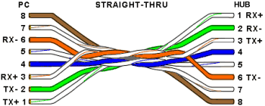

Slide 6
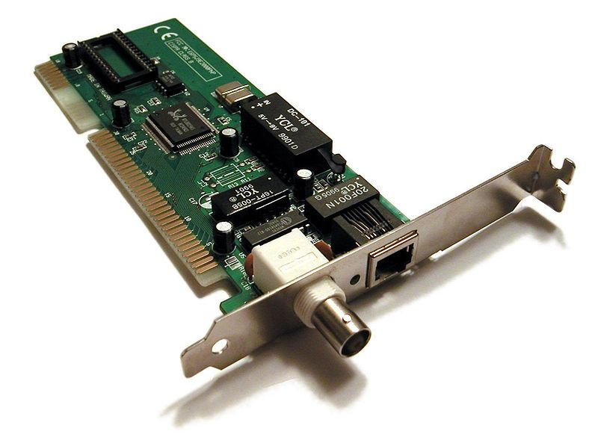
Network card

Slide 7
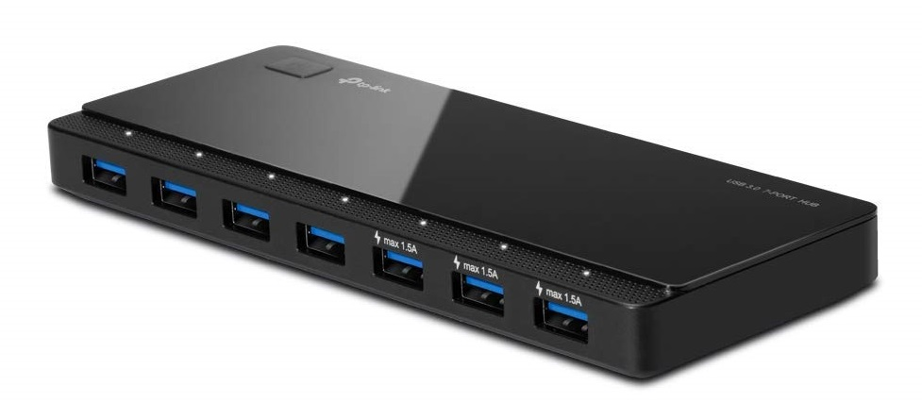
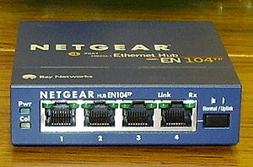
HUB

Slide 8
It is Not-intelligent device.
It has only one collision Domain.
It has only one broadcasting domain

Slide 9
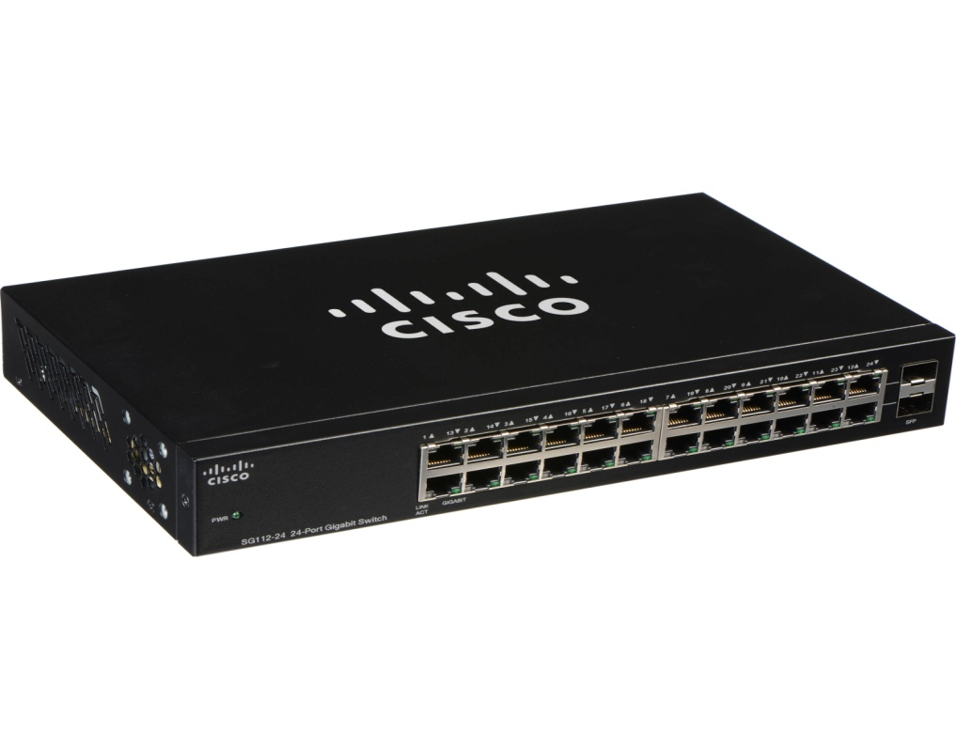
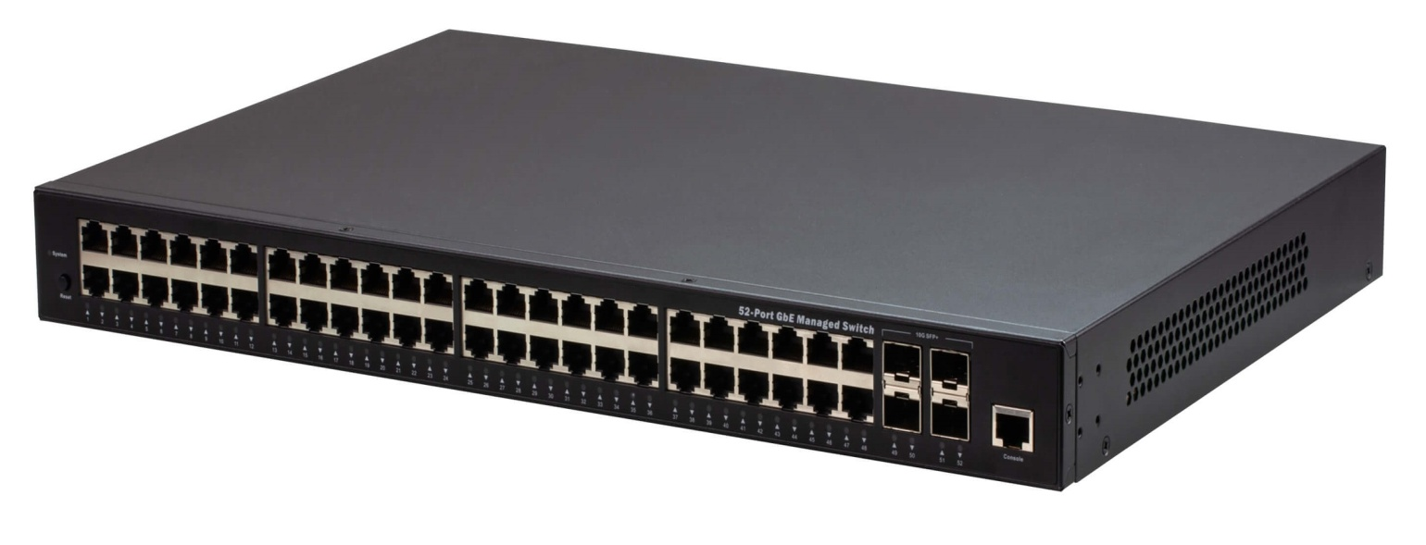
Switch
Cisco switches do not have an power switch.

Slide 10
It is an Intelligent device.
It works on ASIC(Application Specific Integration Security). i.e It has features of storing MAC address information.
Since it can communicate through MAC recognization technique, So it doesn’t collaborate with each other.
It has only one broadcast domain.

Slide 11
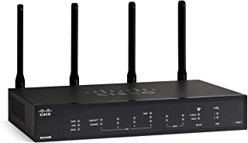
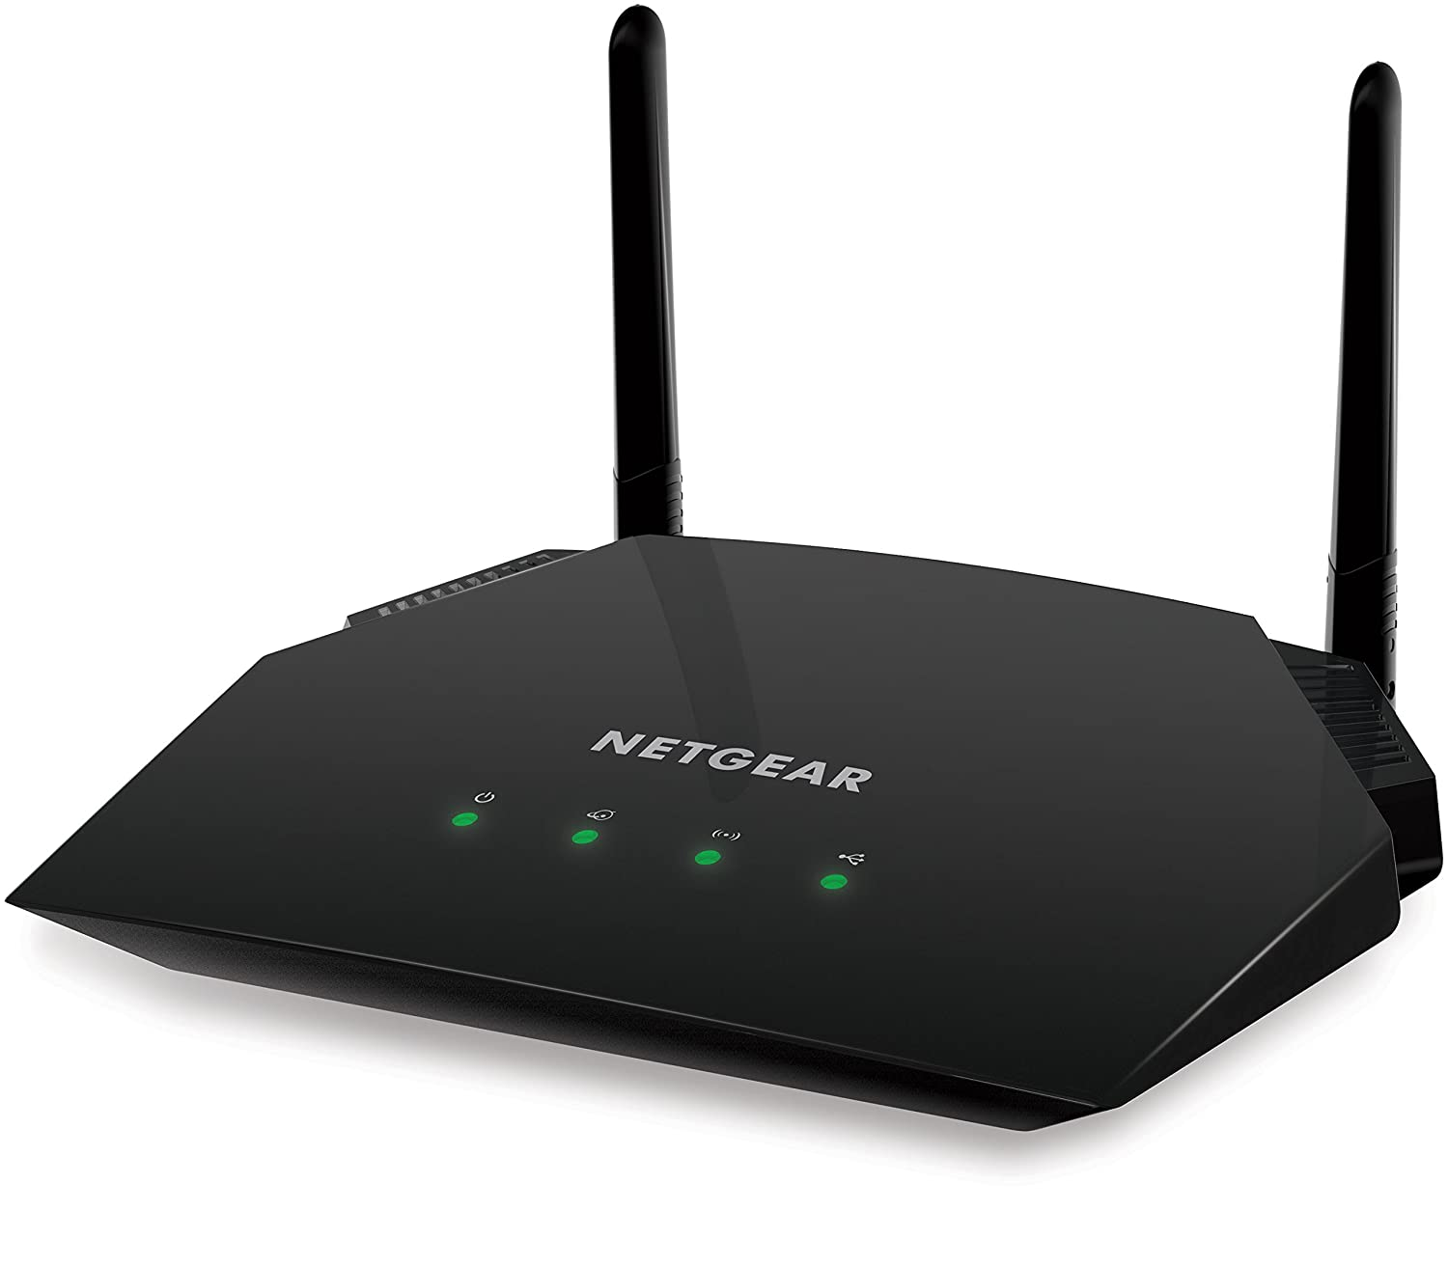
ROUTER

Slide 12
It is an very intelligent device.
It has many collision Domain.
It has many broadcasting domain.
It is called a border device.
each information of the router will be connected to a different network

